Slide 1
Differential equations
Eric Prebys

Slide 2
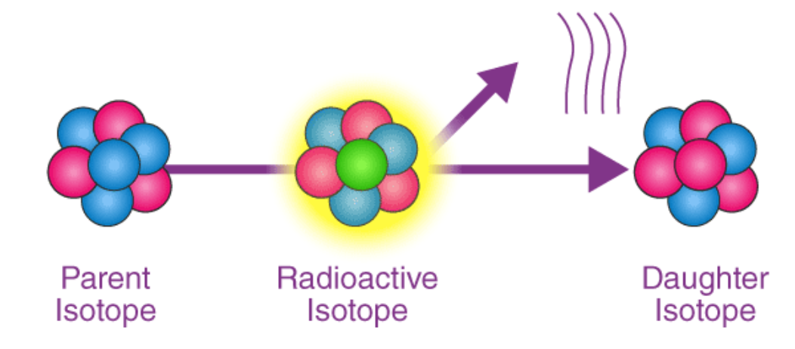
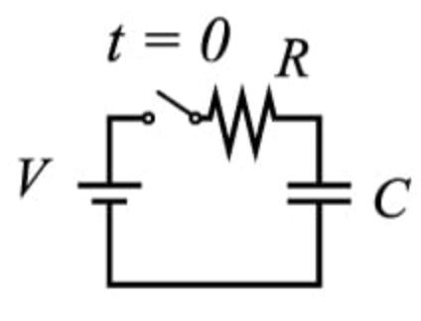
Differential Equations in Physics
Virtually everything in physics is described by differential equations. Some one dimensional examples
Radioactive decay
Charging a capacitor
Gravitational motion with turbulent drag
Sign depends on direction!

Slide 3
Formalism
You’ve dealt with a number of specific differential equations in physics, which typically have specific forms.
For example a damped-driven harmonic oscillator (or LC circuit, quantum state, etc) has the form
which is a linear differential equation with constant coefficient. A non-zero F(t) term makes in “inhomogeneous”.
But this is not the most general form of differential equation.
We will start with ordinary differential equations (ODE), in which one variable y is uniquely dependent on another variable x, ie
Note that in practice, the dependent and independent variables may have different names. In the oscillator example

Slide 4
Formalism (cont’)
The “order” of an ODE is the highest order derivative of y, and the standard format is to express that as a function of x,y, and all lower order derivatives
Fpr example
In general, I’ll need a number initial conditions equal to the order of the equation. For my previous examples.
For the first two first order equations, I’ll need to know the initial amount or radioactive material N(0) or charge Q(0).
For the third, second order example, I’ll need to know
The initial position x(0)
The initial velocity x’(0)=v(0)
First order
Second Order

Slide 5
Explicit Solutions
You’ve learned many tricks for solving differential equations.
For example, if a first order ODE can be expressed as Then we can express the solution as integrals.
IF both sides are explicitly integrable, we will have a least a transient solution, where the constant of integration is determined by the initial condition.

Slide 6
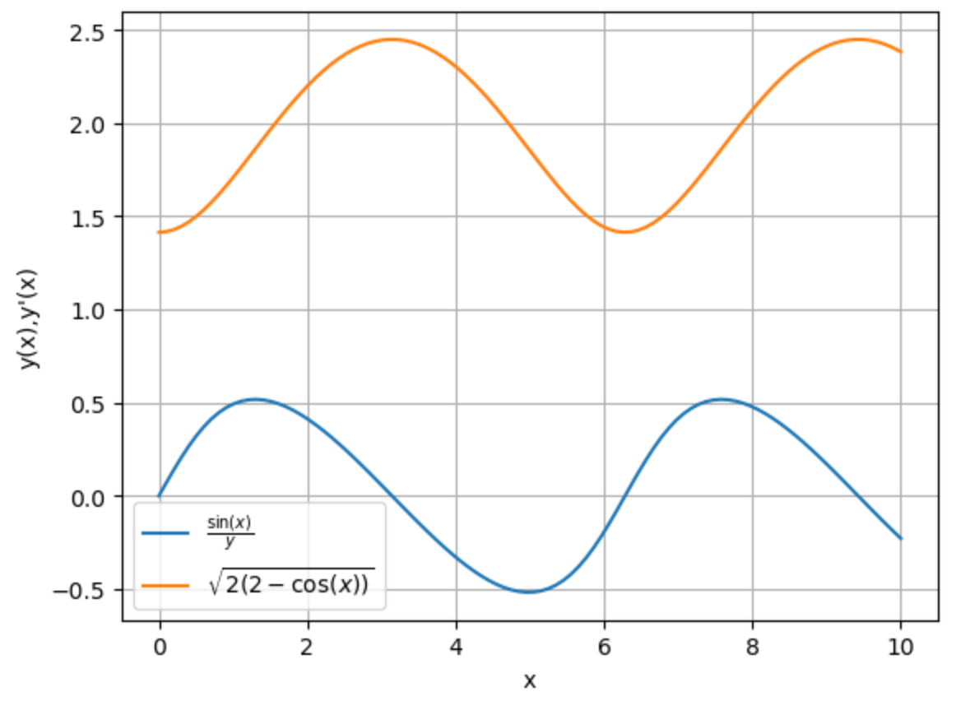
Example
Example
Integrate
General solution
Solve for initial condition
Explicit solution

Slide 7
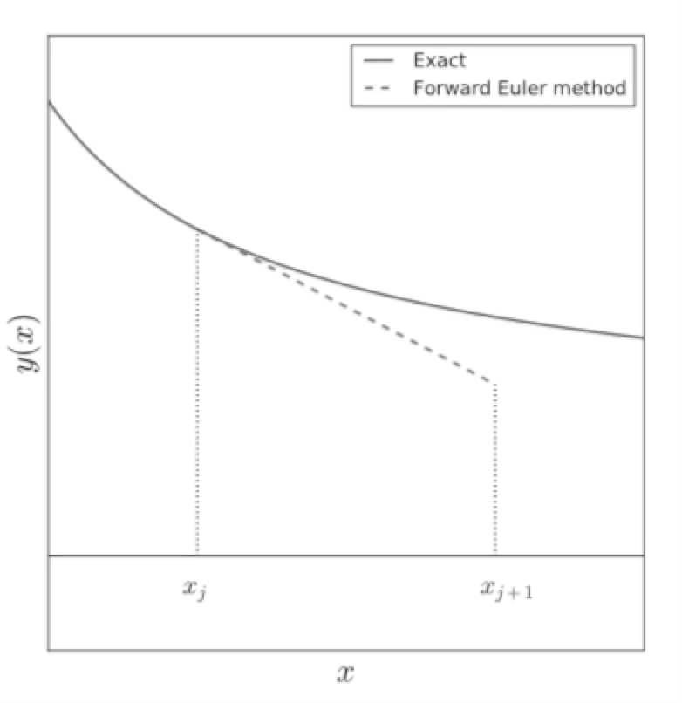
Numerical Solutions: Euler Method
General approach:
Start at the initial point
Use discrete steps to estimate the derivative and evolve the function to the next step.
Start at point a
Step to point b in discrete steps

Slide 8
Extrapolating
Generalizing forward derivative techniques
We can turn around and extrapolate to the next value of y with
Note, we can also work backwards by simply flipping the sign of h

Slide 9
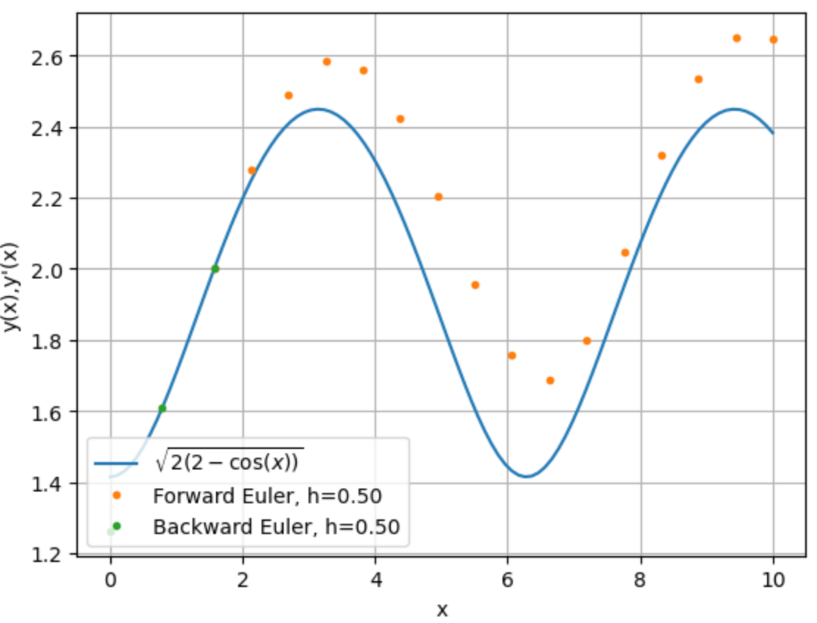
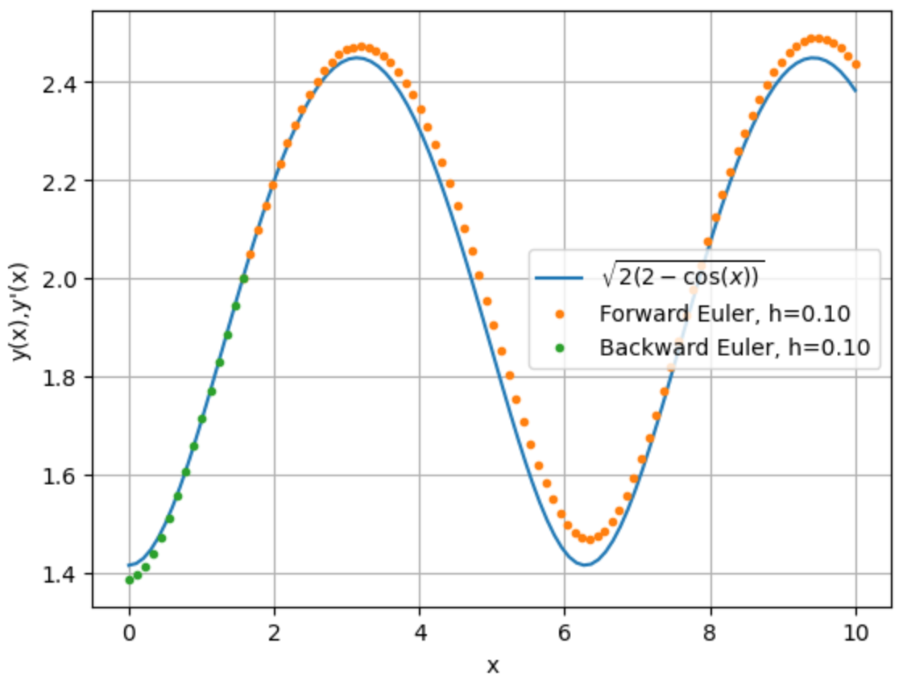
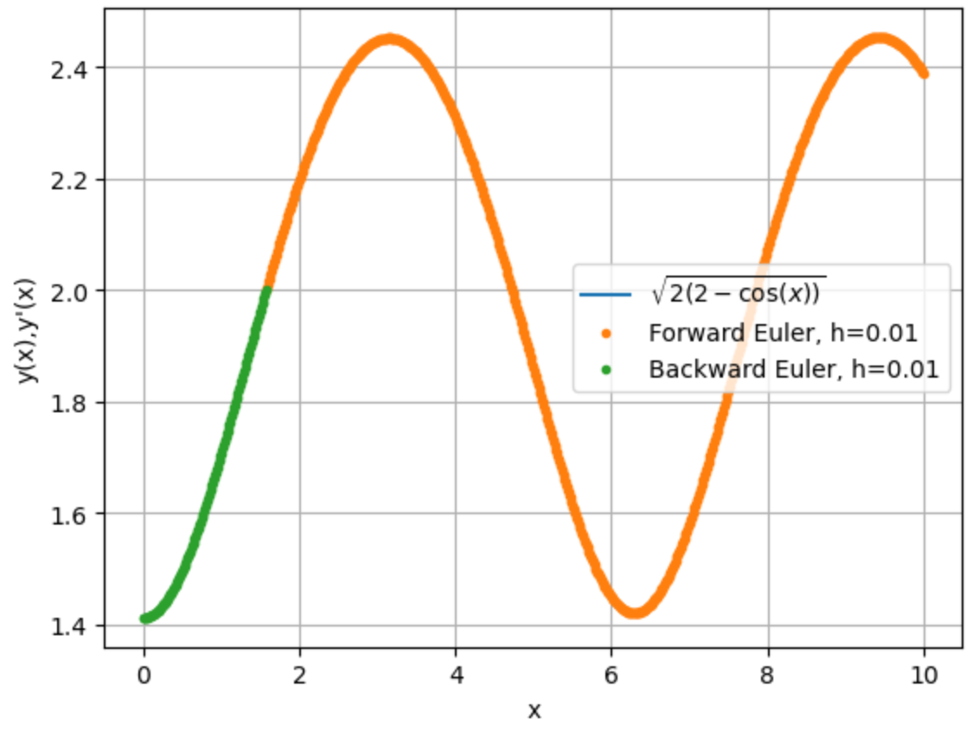
Test it on our explicit example (Notebook)

Slide 10
Numerical Solutions to 2nd Order ODE
We can apply our Euler technique to 2nd order ODEs as well, by extrapolating both the position and the first derivative. Starting with y(0) and y’(0), extrapolate with
Extrapolate y’ the same way I extrapolated y before
Extrapolated y using the extrapolated values of y’

Slide 11
Example: Harmonic Oscillator
Our usual way to write this is
And we know the solution is
Initial conditions:

Slide 12
Expressing it in our formalism…
We rearrange our expression:
Note that in our usual formalism
You won’t believe how much time I wasted getting this wrong!

Slide 13
Dimentionless Time
For an explicit solution, I can always just plug in different values for k and m, but if I’m doing a numerical solution, I’d rather not re-run it for different values.
Then if I find x as a function of τ, I can express it as a function of time as
In these units, our equation and solutions become

Slide 14
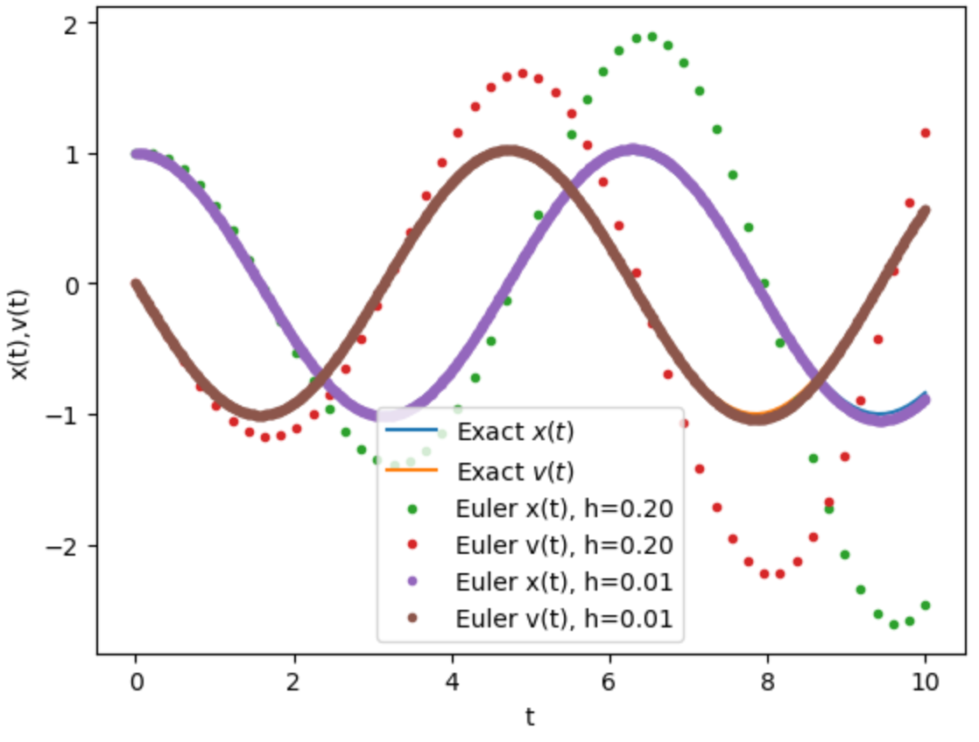
Example
Use
Go to notebook…

Slide 15
Adding Damping
We add a damping force given by
And our equation becomes
Damping factor

Slide 16
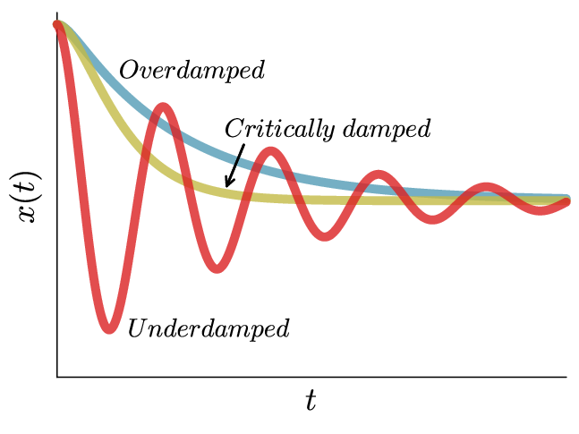
Explicit Solutions
We can solve this explicitly for particular values of η…
Underdamping (η<<1):
Critical Damping (η=1):
Overdamping (η=1):
Slow
Go to Notebook
Fast

Slide 17
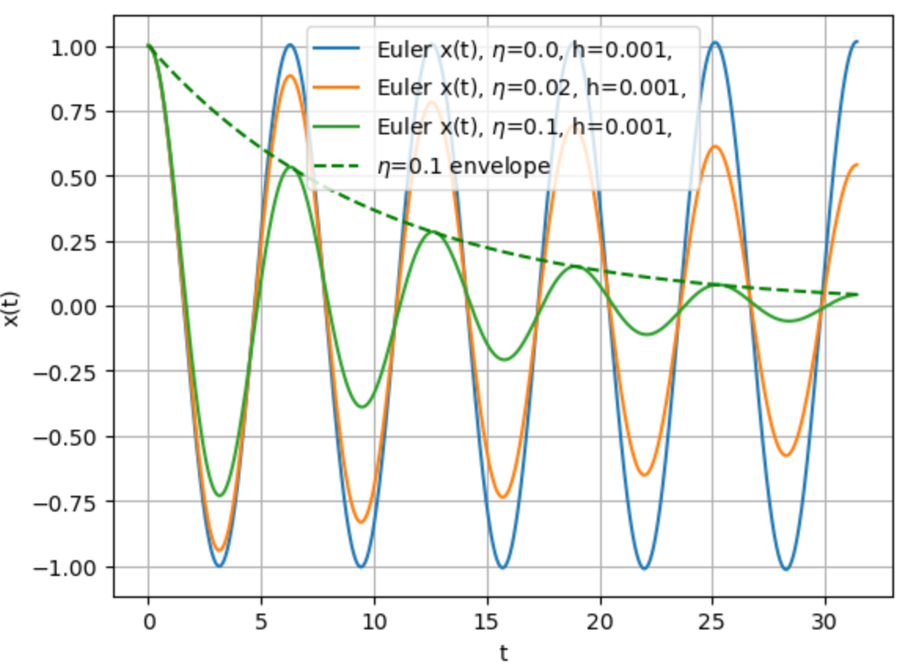
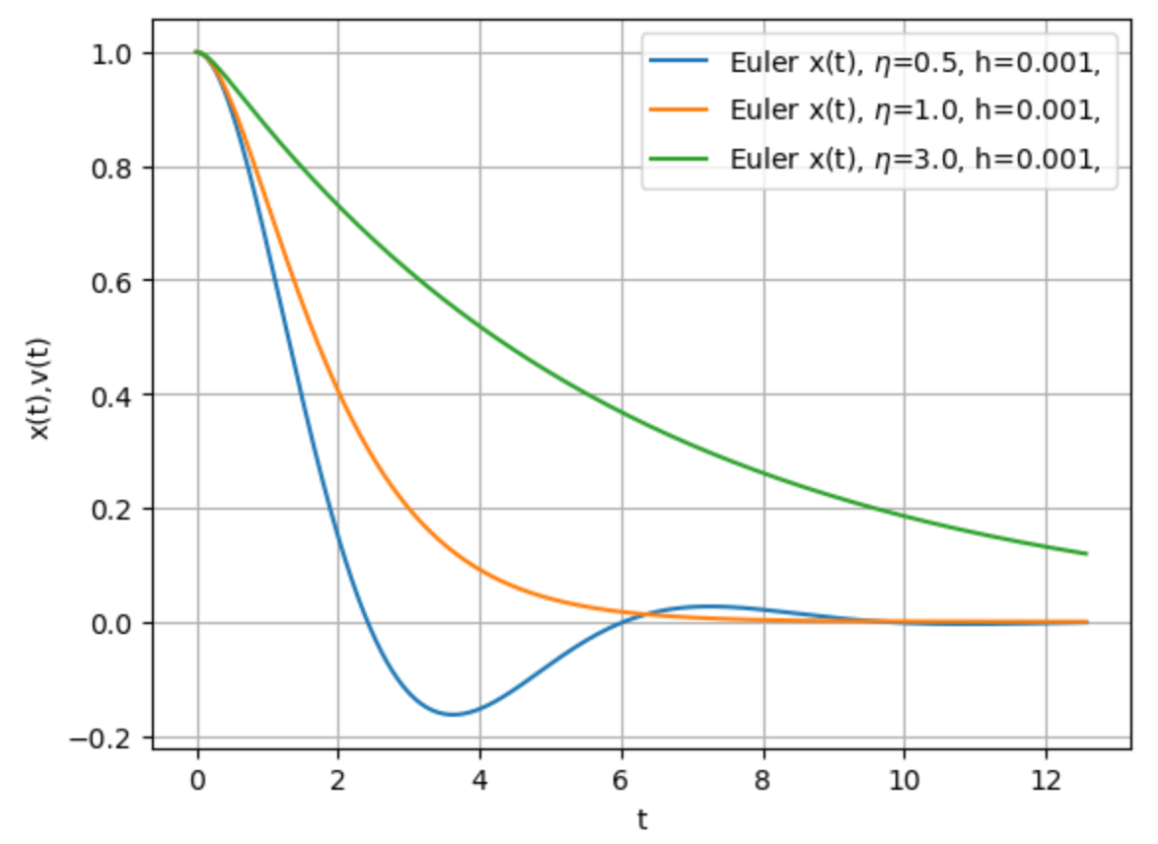
Numerical Examples
Critically damped
Overdamped
Underdamping
Transition to overdamping
Slightly underdamped

Slide 18
Transition to Turbulent Drag
Turbulent drag has the form
Our equation now becomes

Slide 19
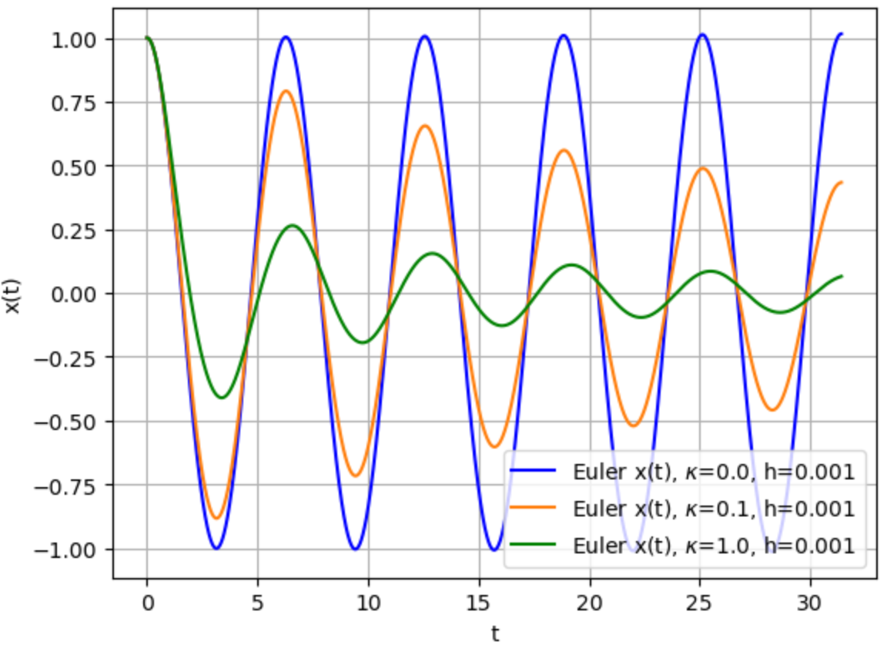
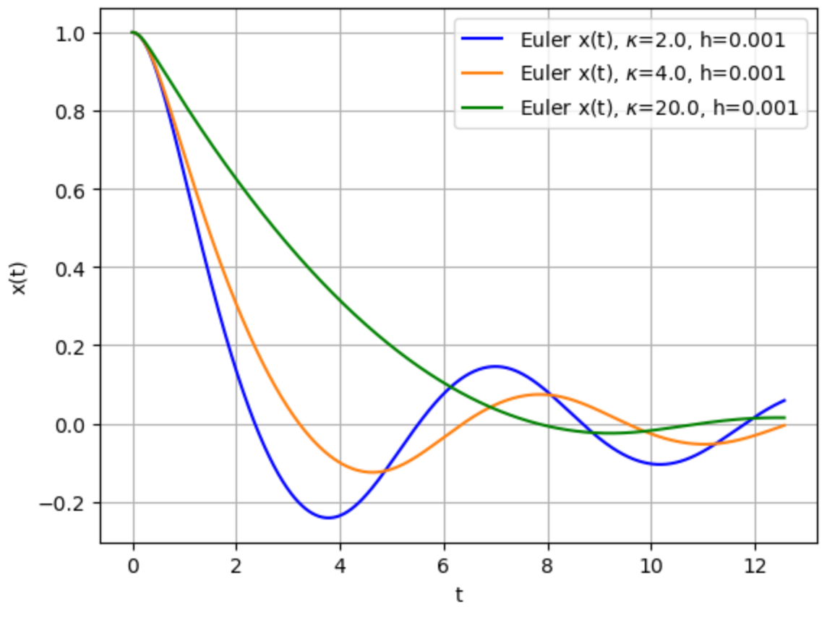
Numerical Examples
No critical damping
Light Damping
Heavy Damping

Slide 20
Generic Representation of ODEs
To avoid yet more confusion, I’m going to switch to the Python formalism for ODEs
Independent variable t
Dependent variable y
For our Euler extrapolation of an nth order ODE, we extrapolate each point to the next based on its derivative
More generally, we can calculate the infinitesimal change of the vector of dependent variables and derivatives as a function of their current values and the independent variable

Slide 21
Applying this to our Oscillator
We define our vector as
And our rate of change will be
Which in this linear case can be represented by a matrix operation.
But that’s not a requirement to solve the problem

Slide 22
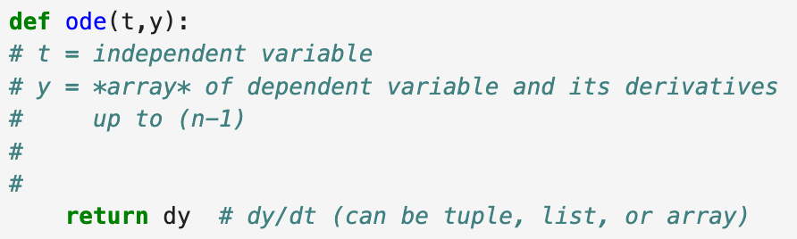
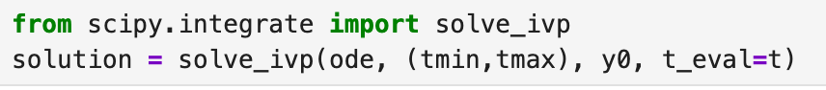
Using scipy.integrate.solve_ivp()
We need to define an ode function of the form
We then solve it with the initial value problem solver
ode function
Time range
Time points to evaluate
Initial values
Go to notebook…

Slide 23
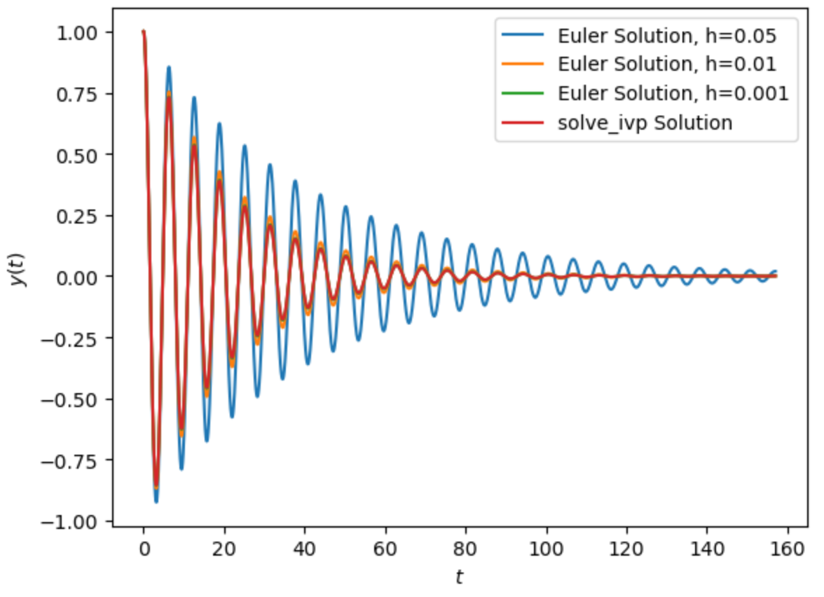
Euler vs. ivp_solver
Euler not accurate for larger h

Slide 24
Adding a driving term
If we add a driving term, our equation becomes
Use a driving term of the form
Go to notebook…
Explicit time dependence

Slide 25
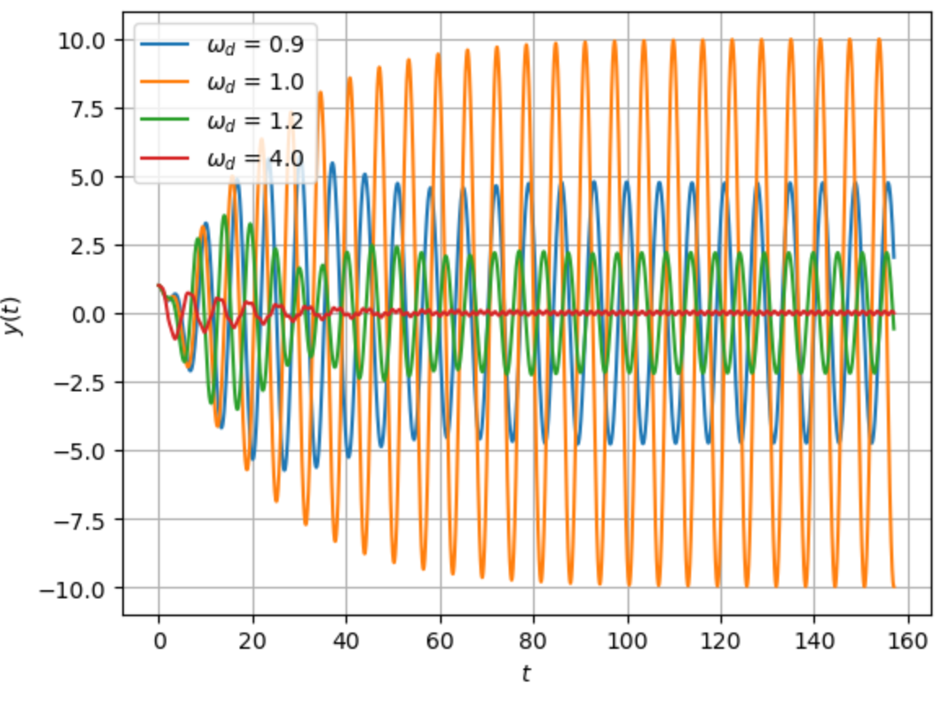
Resonant Behavior

